Slide 1

Digital Design and Verification Training
Digital System Design

Slide 2
Agenda
Combinational Circuits
Sequential Circuits
FSM

Slide 3
Combinational Circuits
What are Combinational circuits?

Slide 4
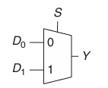
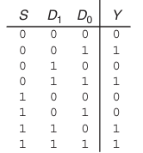
Combinational Circuits
MUX

Slide 5
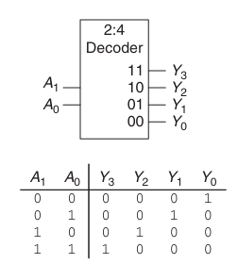
Combinational Circuits
Decoder

Slide 6
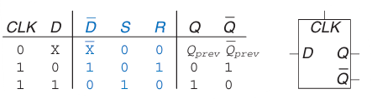
Latch
D-Latch

Slide 7
Sequential Circuits
What are sequential circuits?

Slide 8
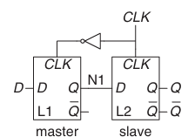

Flip Flop
D-Latch

Slide 9
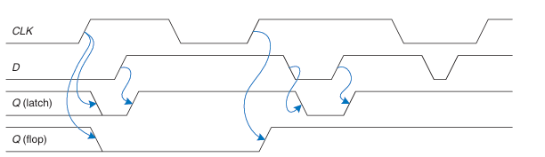
Flip Flop

Slide 10
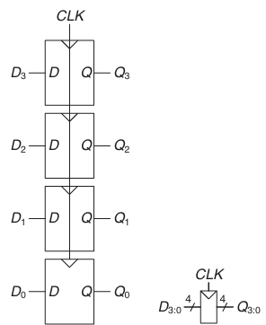
Register

Slide 11

Enabled Flip Flops

Slide 12

Resettable Flip Flops
Asynchronous reset: reset themselves as soon as RESET becomes TRUE, independent of CLK.
Synchronous reset: reset themselves only on the rising edge of CLK.

Slide 13
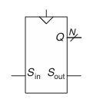
Shifters
Serial to Parallel
Parallel to Serial.

Slide 14
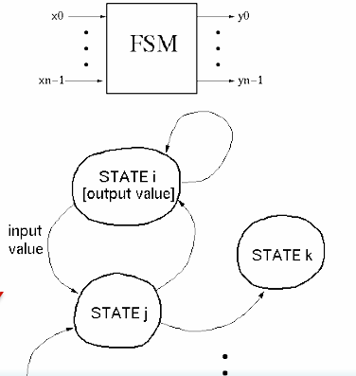
Finite State Machines
Can model behavior of any sequential circuit
Useful representation for designing sequential circuits
Output depends on present and past inputs
Effect of past inputs represented by the current state

Slide 15
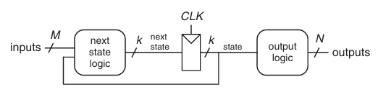
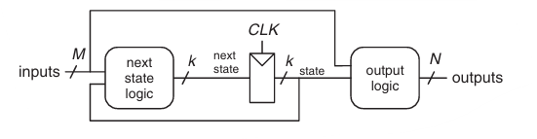
Finite State Machines
Moore Machine
Mealy Machine

Slide 16
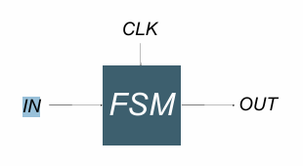
Finite State Machines
Example: Edge Detector Bit are received one at a time (one per cycle), such as: 000111010 time Design a circuit that asserts its output for one cycle when the input bit stream changes from 0 to 1. We'll try two different solutions: Moore then Mealy.

Slide 17
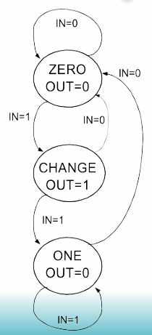
Finite State Machines
Moore Solution

Slide 18
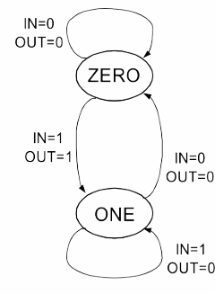
Finite State Machines
Mealy Solution

Slide 19
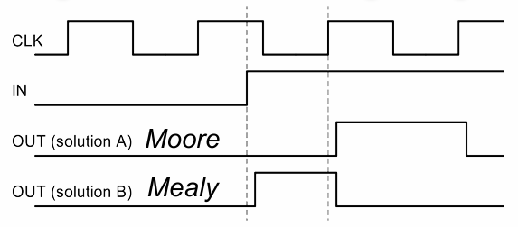
Finite State Machines
Mealy Solution

Slide 20
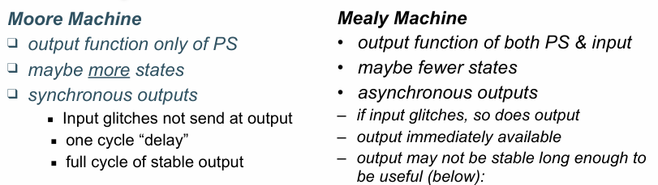
Finite State Machines

Slide 21
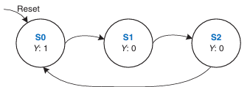
Finite State Machines
One Hot State Encoding:
In one-hot encoding, a separate bit of state is used for each state.
one bit is “hot” or TRUE at any time.

Slide 22
Finite State Machines
One Hot State Encoding:
In one-hot encoding, a separate bit of state is used for each state.
one bit is “hot” or TRUE at any time.

Slide 23
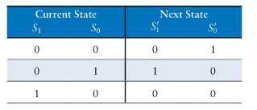
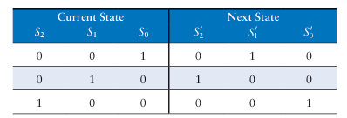
Finite State Machines
Binary Encoding:
One-hot Encoding

Slide 24
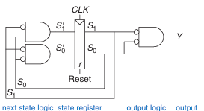

Finite State Machines
Binary Encoding:
One-hot Encoding
Notes:
Why one-hot encoding? ▪ Simple design procedure. –Circuit matches state transition diagram (example next page). ▪ Often can lead to simpler and faster “next state” and output logic. ❑ Why not do this? ▪ Can be costly in terms of Flip-flops for FSMs with large number of states.

